Slide 1
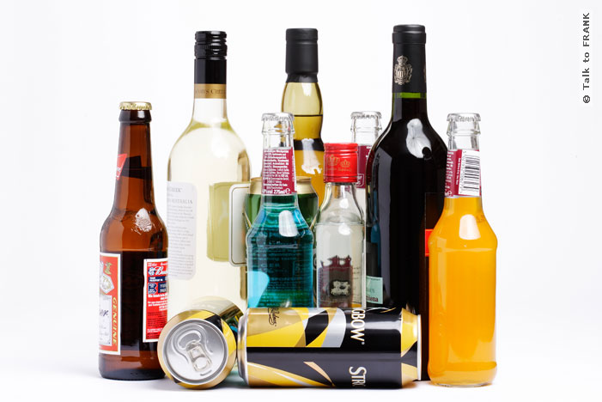
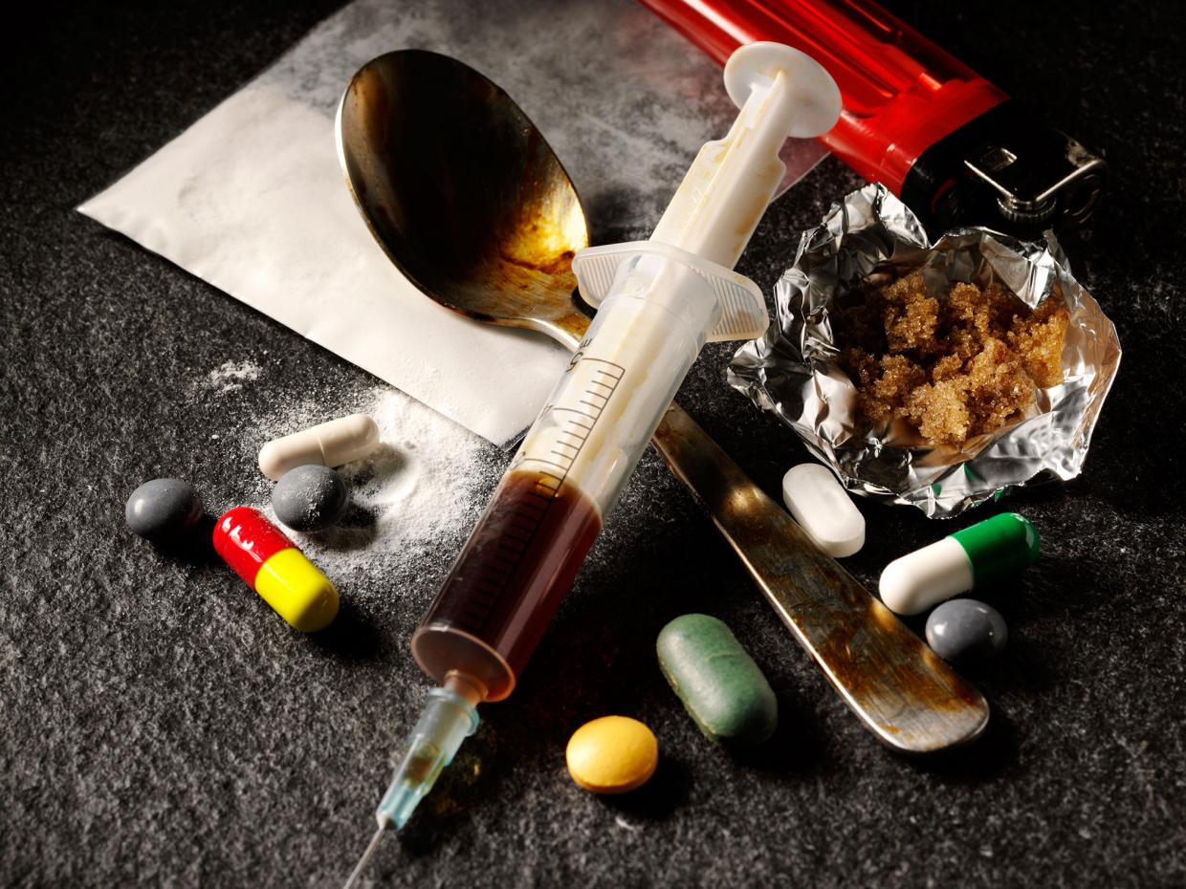
Substance Abuse & its Consequences
Notes:
Alcohol picture: http://www.talktofrank.com/drug/alcohol
Drug picture: http://thenortheasttoday.com/tag/drugs/

Slide 2
Definitions
Physical Dependence
State in which an abstinence syndrome (withdrawal symptoms) will occur if the dependence producing drug is abruptly withdrawn
Abuse
Drug use that is NOT consistent with medical or social norms
Addiction
A pattern characterized by continued use of a substance despite physical, psychological, or social harm
Notes:
Lehne, Richard. (2013). Pharmacology for Nursing Care. 8th ed. Elsevier. St. Louis, MO.

Slide 3
Cigarettes & Your Body
Lung disease – leading to lung cancer
Heart disease – leading to heart attack
Difficult to get pregnant – can affect baby’s health
Destroys teeth & gums – causing tooth loss
Causes thinning of hair/balding
Decreased body’s defense – can get sick easily
Cigarette smell – toxic odor lingering on clothes, hair, breath that can repel people from you and is very harmful to children
Smoking even one cigarette in your life or exposure to secondhand smoke increases your risk of disease and death!

Slide 4
TWIN B
Wrinkles or crows feet (wrinkles around eyes)
Loose skin
(eye bags)
Lines around mouth

Slide 5
Which twin is the smoker?

Slide 6
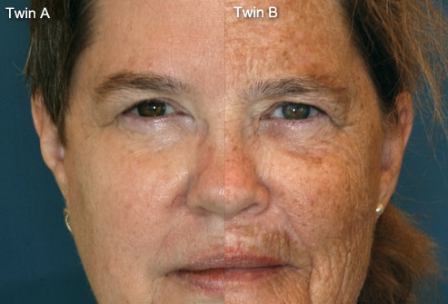
Lines around mouth from over use of muscles
Smoking leads to higher risk of uneven skin tone/dark blotchy skin & skin damage from the sun

Slide 7
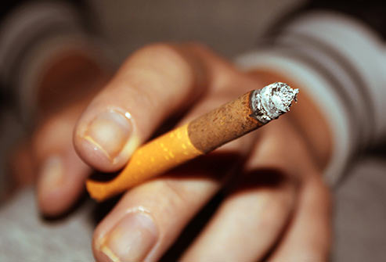
Damaged teeth & gums
Bad breath
Yellow teeth
Sores and oral cancer
Stained/yellow nails and skin

Slide 8
Psoriasis – skin condition
Thick, scaly patches on skin
White, red, or silver color
Itchy
On hands, elbows, knees, scalp, or back

Slide 9
Which one is the healthy lung?
Enlarged heart

Slide 10
Tar filled, black lungs

Slide 11
Marijuana
Phlegmy cough, wheezing, lung infections
Marijuana smoke has toxins/carcinogens that irritate lungs and can cause cancer
Rapid heart rate for up to 3 hours
Bloodshot eyes
For young people, lasting impact on thinking & memory skills
If using while pregnant, will affect brain of baby
Decrease immunity – can easily get sick

Slide 12
Alcohol
Kills brain cells – poor coordination, change mood & behavior, harder to think
Dehydration
Damages liver – cirrhosis
High blood pressure – heart problems
Poor immune system – likely to get sick, can’t fight illness
Causes pancreas to make toxic substance
High risk for digestive system cancers, liver cancer, breast cancer
If drinking while pregnant, can cause FAS (fetal alcohol syndrome) – causing birth defects, decreased brain function/growth, abnormal facial features

Slide 13
Faces of Drug Addiction
http://www.rehabs.com/explore/faces-of-addiction/
Notes:
http://www.mirror.co.uk/news/world-news/faces-meth-horrific-transformation-fresh-faced-4705220

Slide 14
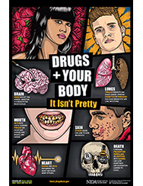
Drugs and Your Body
Organ Damage
Lungs
URI, asthma, phlegm build up, bronchitis
Heart
Clots leading to stroke
Irregular heartbeat
Flat line leading to death
Hormone Imbalance
Acne
Skin
Picking r/t meth use
Cancer
Prenatal and fertility issues
GI disease
HIV/AIDS
R/t contaminated needles
Notes:
Photos: http://mediak.ektf.hu/?p=6816
http://www.scholastic.com/drugs%2Dand%2Dyour%2Dbody/heart.htm

Slide 15
Neurological & Emotional Effects
Depression
Anxiety
Memory Loss
Marijuana is linked to lower IQ
Consuming excess amounts of alcohol impairs memory
Aggression
Cocaine, meth, steroid, and prescription drug us
Mood Swings
Paranoia
Psychosis
Notes:
https://www.summitbehavioralhealth.com/resources/articles/consequences-of-addiction/
Photo: http://drugabuse.com/guides/substance-abuse-and-diabetes/

Slide 16
Legal Consequences of Drugs
Arrest
Probation
Juvenile detention (incarceration)
A juvenile 14 years old and over who is charged with a drug- related offense can be treated as an adult in criminal court.
Anyone convicted of simply having any type of illegal drug in a drug-free school zone will have to do at least 100 hours of community service.
Notes:
http://eschooltoday.com/drug-abuse-and-teens/consequences-of-drug-abuse.html
https://www.teenrehabcenter.org/resources/drugs-crime-legal-issues/
http://www.drugpolicy.org/drug-law-convictions-and-punishments

Slide 17
Long-term Consequences
Criminal Record
You will have a criminal record on file with the police.
A criminal record jeopardizes many other opportunities
Educational Aid
Drug-related offenses make you ineligible for financial aid
Bye bye free money
Travel
Many countries will refuse travel into their country and will refuse issuance of a visa for drug-related offenses
Social Status
Many people discriminate against those with criminal records.
Notes:
http://eschooltoday.com/drug-abuse-and-teens/consequences-of-drug-abuse.html
https://www.teenrehabcenter.org/resources/drugs-crime-legal-issues/
http://www.drugpolicy.org/drug-law-convictions-and-punishments

Slide 18
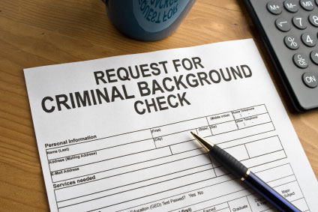
Consequences for Career
Career & Employment
Many employers turn down applicants that have criminal backgrounds
Barred from enlisting in the military
Substance dependence (even if a legal substance such as alcohol) can effect:
Job performance and productivity
Ability to meet employer’s standards
Safety of others
Poor coping with stress and anxiety
r/t substance abuse
Can lead to conflicts among coworkers
Limits growth within the company
Notes:
http://www.alternativesintreatment.com/general-addiction/5-ways-addiction-affects-career/
https://www.addictionhope.com/prescription-drugs/professionals-and-employers-drug-addiction/

Slide 19
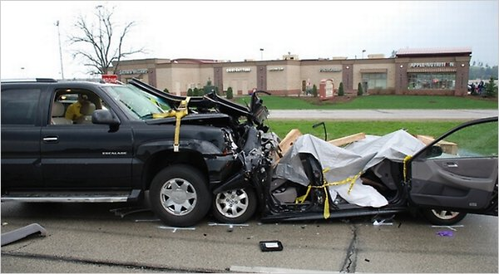
Adolescent Substance Abuse
Brain has not yet fully developed making them more prone to addiction
Teen substance abuse puts them at greater risk for:
Major injury (Ex. MVA)
Contracting HIV and other STDs
Death related to:
Suicide
Homicide
Accident
Illness
Notes:
https://www.summitbehavioralhealth.com/resources/articles/consequences-of-addiction/
Image: Driver was on prescription drugs and crashed killing 2 people.
http://www.nytimes.com/2010/07/25/us/25drugged.html?_r=0

Slide 20
Sources:
Lehne, Richard. (2013). Pharmacology for Nursing Care. 8th ed. Elsevier. St. Louis, MO.
http://www.alternativesintreatment.com/general-addiction/5-ways-addiction-affects-career/
https://www.addictionhope.com/prescription-drugs/professionals-and-employers-drug-addiction/
http://eschooltoday.com/drug-abuse-and-teens/consequences-of-drug-abuse.html
https://www.teenrehabcenter.org/resources/drugs-crime-legal-issues/
http://www.drugpolicy.org/drug-law-convictions-and-punishments
http://drugabuse.com/guides/substance-abuse-and-diabetes/
https://www.summitbehavioralhealth.com/resources/articles/consequences-of-addiction/
http://www.nytimes.com/2010/07/25/us/25drugged.html?_r=0
http://mediak.ektf.hu/?p=6816
http://www.scholastic.com/drugs%2Dand%2Dyour%2Dbody/heart.htm
http://thenortheasttoday.com/tag/drugs/
http://www.talktofrank.com/drug/alcohol
https://www.cdc.gov/tobacco/data_statistics/fact_sheets/health_effects/effects_cig_smoking/
http://www.webmd.com/smoking-cessation/ss/slideshow-ways-smoking-affects-looks
http://www.rehabs.com/explore/faces-of-addiction/
http://www.healthline.com/health/addiction/marijuana/effects-on-body
https://www.niaaa.nih.gov/alcohol-health/alcohols-effects-body
http://pubs.niaaa.nih.gov/publications/Hangovers/beyondHangovers.pdf
http://www.mirror.co.uk/news/world-news/faces-meth-horrific-transformation-fresh-faced-4705220

